Slide 1

MedRAG: A Hybrid Retrieval-Augmented Generation System for AI + Healthcare Research

Slide 2
Agenda
1
MedRAG: A Hybrid Retrieval-Augmented Generation System for AI + Healthcare Research
2
Problem Statement: Why MedRAG? Addressing LLM Limitations in Healthcare AI
3
Understanding Retrieval-Augmented Generation (RAG): The Core Idea
4
Limitations of Naive RAG: Insufficiency for Healthcare Research
5
MedRAG: A Hybrid Retrieval-Augmented Generation Approach
6
MedRAG Architecture: Detailed Pipeline Overview
7
Knowledge Base Construction: Dataset and Indexing
8
Evaluation Setup: Experimental Design and Scoring
9
Baseline RAG Results: Performance Without Enhancement Stage
10
Full MedRAG Results: Performance With Hybrid Enhancement
11
Quality vs. Latency Trade-Off: Performance Comparison
12
Ethical & Safety Measures: The Medical Validator Agent
13
Limitations: Acknowledging Current Constraints
14
Future Work: Enhancing MedRAG Capabilities
15
Conclusion: MedRAG's Impact on AI + Healthcare Research

Slide 3


MedRAG: A Hybrid Retrieval-Augmented Generation System for AI + Healthcare Research
Presenter: Sagar Y, M.Tech AI & DS, VIT Bhopal University
Innovative Approach
MedRAG represents a pioneering methodology that synergizes AI capabilities with healthcare research, aiming to bridge the gap between technological advancements and clinical applications.
Enhancing AI Capabilities
By leveraging retrieval-augmented generation, MedRAG enhances the ability of AI systems to provide accurate, timely, and contextually relevant information in healthcare settings.
Notes:
Today, I am excited to present MedRAG, a groundbreaking hybrid retrieval-augmented generation system designed specifically for the healthcare domain. As we navigate the complexities of AI in healthcare, it is crucial to develop innovative approaches that not only enhance AI capabilities but also ensure that these advancements are applicable and beneficial in real-world medical contexts.

Slide 4



Problem Statement: Why MedRAG? Addressing LLM Limitations in Healthcare AI
Static Knowledge Cutoffs
Large Language Models (LLMs) often have fixed knowledge cutoffs, which can lead to the dissemination of outdated or irrelevant information in fast-evolving fields like healthcare.
Dangers of Outdated Information
In medical contexts, relying on outdated or hallucinated responses can have dire consequences, potentially compromising patient safety and care quality.
Resource-Intensive Retraining
Frequent retraining of LLMs to keep pace with new research is not only computationally expensive but also impractical for dynamic knowledge bases in healthcare.
Notes:
The healthcare landscape is characterized by rapid advancements and continuous research, which poses significant challenges for traditional LLMs. These models often operate with static knowledge cutoffs, leading to outdated information that can jeopardize patient safety. Moreover, the computational burden of frequent retraining makes it impractical to maintain an up-to-date AI system. MedRAG aims to address these limitations by providing grounded, safe, and current research answers without the need for constant model updates.

Slide 5
Understanding Retrieval-Augmented Generation (RAG): The Core Idea
Core Mechanism
The essence of RAG lies in its ability to retrieve relevant documents from an external, up-to-date knowledge base, ensuring that the information used is current and reliable.
Contextual Evidence Injection
By injecting retrieved evidence directly into the LLM prompt, RAG enhances the context, allowing for the generation of responses that are grounded in verifiable research.
Reduction of Hallucination
This approach significantly mitigates the risk of hallucination in LLM outputs, as responses are based on real, factual data rather than the model's static knowledge.
Notes:
At the heart of MedRAG is the concept of Retrieval-Augmented Generation, which fundamentally transforms how AI systems interact with knowledge. By retrieving relevant documents from a dynamic knowledge base and injecting this evidence into the LLM's prompt, we can generate responses that are not only accurate but also grounded in the latest research. This mechanism effectively reduces the incidence of hallucination, ensuring that the information provided is both reliable and relevant.

Slide 6
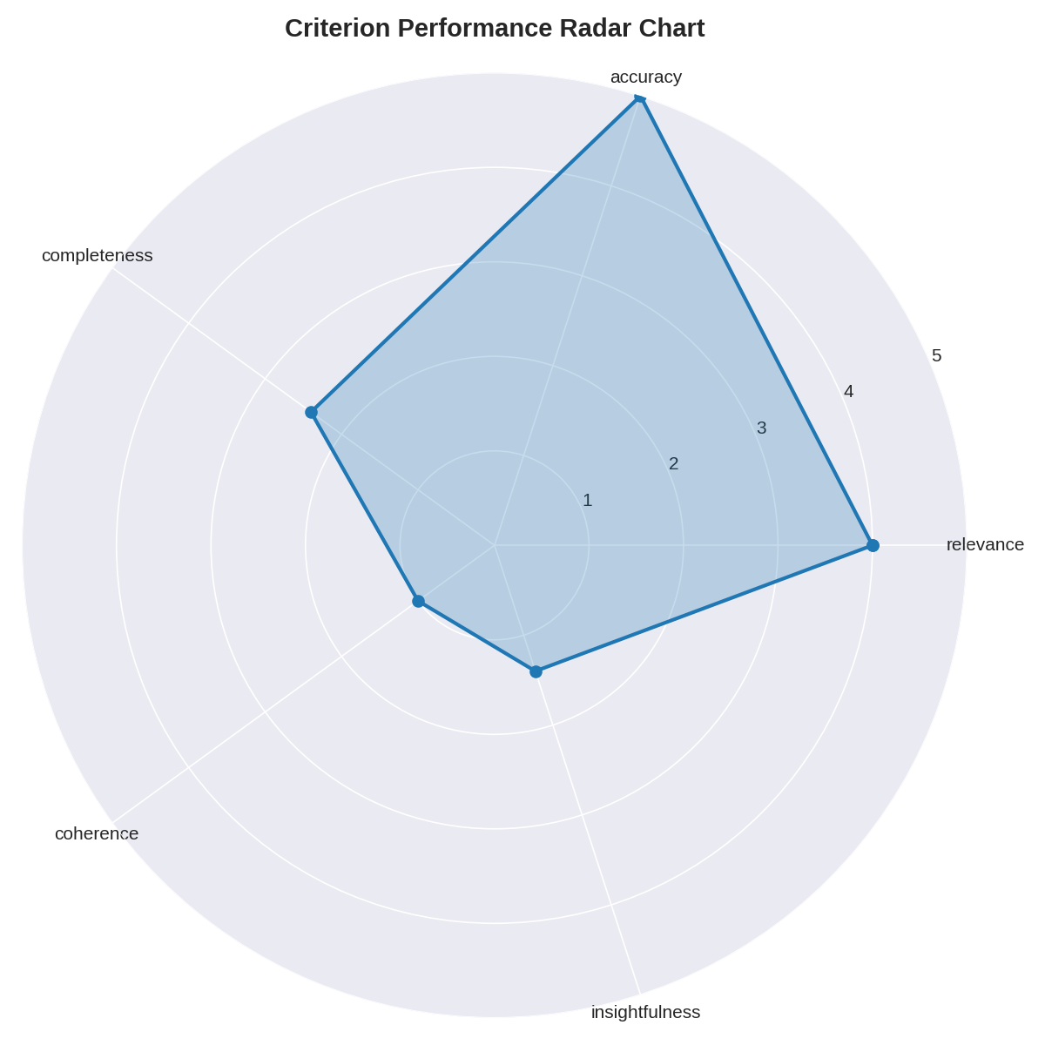
Limitations of Naive RAG: Insufficiency for Healthcare Research
Shallow Responses: Naive RAG often yields responses that are superficial and lack the depth required for complex healthcare inquiries, limiting its effectiveness.
Repetitive Outputs: The tendency to produce repetitive answers diminishes the overall quality and engagement of the generated content, making it less useful for nuanced discussions.
Lack of Coherent Reasoning: Despite factual correctness, naive RAG struggles with providing structured and coherent reasoning, which is essential for advanced healthcare research tasks.
Photo by Alexander Grey on Unsplash
Notes:
While Retrieval-Augmented Generation holds promise, naive implementations often fall short in the context of healthcare research. They tend to produce shallow and repetitive answers, lacking the sophisticated structure and coherent reasoning necessary for addressing complex medical inquiries. This insufficiency highlights the need for a more advanced approach that can meet the demands of healthcare research intelligence.

Slide 7

MedRAG: A Hybrid Retrieval-Augmented Generation Approach
Modular Design Philosophy: MedRAG employs a modular, multi-stage pipeline that allows for enhanced performance by specializing each component for distinct roles within the system.
Balancing Accuracy and Completeness: The design aims to achieve a critical balance between accuracy, completeness, and safety in the outputs generated, ensuring high-quality responses.
Chaining Smaller Models: Instead of relying on a single large model, MedRAG chains together smaller, efficient models, optimizing performance and resource utilization.
Photo by Ousa Chea on Unsplash
Notes:
MedRAG's design philosophy revolves around creating a hybrid retrieval-augmented generation system that is both modular and efficient. By employing a multi-stage pipeline, we can specialize each component to perform distinct roles, ultimately achieving a balance between accuracy, completeness, and safety. This approach allows us to chain smaller models together, enhancing performance while optimizing resource utilization.

Slide 8
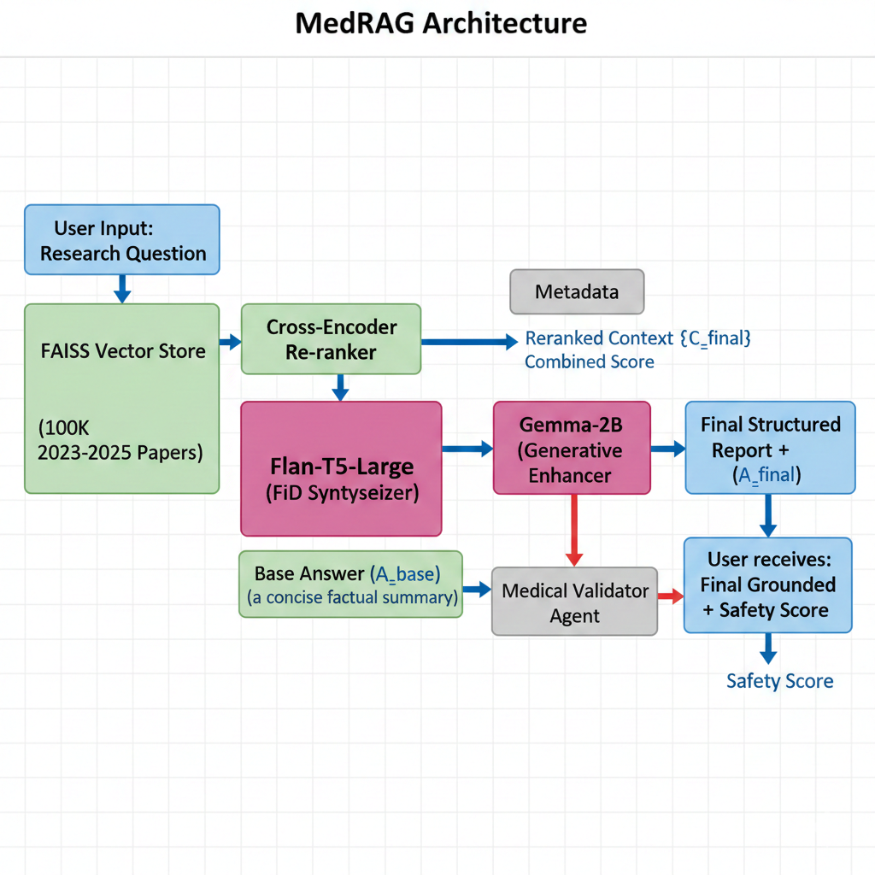
MedRAG Architecture: Detailed Pipeline Overview
FAISS Retriever: This component is responsible for efficiently retrieving the top-K relevant research documents from the knowledge base, ensuring timely access to information.
Flan-T5 Integration: Flan-T5 synthesizes and integrates information from multiple retrieved sources, enhancing the richness and depth of the generated responses.
Gemma-2B Enhancement Model: This model further processes the synthesized information to produce structured, analytical responses that are coherent and insightful.
Medical Validator Agent: A critical safety component that enforces protocols to ensure non-diagnostic outputs, adhering to ethical guidelines in healthcare.
Photo by Hanna Morris on Unsplash
Notes:
The architecture of MedRAG is designed to facilitate a seamless flow of information through a detailed pipeline. The FAISS Retriever efficiently retrieves relevant documents, which are then synthesized by the Flan-T5 model. The Gemma-2B enhancement model processes this information to generate structured responses, while the Medical Validator Agent ensures that all outputs adhere to safety protocols and ethical guidelines. This multi-faceted approach enhances the overall quality and reliability of the generated insights.

Slide 9




Knowledge Base Construction: Dataset and Indexing
Comprehensive Dataset
The knowledge base comprises approximately 100,000 AI + Healthcare research papers, focusing on the most recent literature from 2023 to 2025.
Multi-Source Aggregation
Research papers are aggregated from diverse, open-access scientific literature, ensuring a broad and inclusive knowledge base.
Efficient Embedding Techniques
Documents are embedded using MiniLM, generating 384-dimensional vectors that facilitate effective similarity-based retrieval.
FAISS Indexing
Indexed with FAISS, the system enables efficient retrieval through cosine similarity, optimizing the search process for relevant documents.
Notes:
The construction of the knowledge base is a critical aspect of MedRAG's functionality. It consists of a comprehensive dataset of approximately 100,000 AI and healthcare research papers, focusing on the most recent literature. By aggregating data from multiple open-access sources, we ensure a rich and diverse knowledge base. The documents are embedded using MiniLM, creating 384-dimensional vectors, and indexed with FAISS for efficient retrieval, allowing us to quickly access relevant information.

Slide 10



Evaluation Setup: Experimental Design and Scoring
Carefully Selected Questions
The evaluation design utilized five representative questions that span various categories, including Technical, Clinical, Implementation, NLP, and Ethics.
Scoring Criteria
Responses were assessed based on a 1–5 scale, evaluating relevance, accuracy, completeness, coherence, and insightfulness.
Exploratory Evaluation Nature
This initial evaluation serves as an exploratory assessment to gauge performance and identify areas for improvement in the MedRAG system.
Notes:
To evaluate the effectiveness of MedRAG, we designed an experimental setup that included five carefully selected representative questions across various categories. The scoring criteria were based on a 1 to 5 scale, assessing key aspects such as relevance, accuracy, completeness, coherence, and insightfulness. This exploratory evaluation provides valuable insights into the system's performance and highlights areas for potential enhancement.

Slide 11
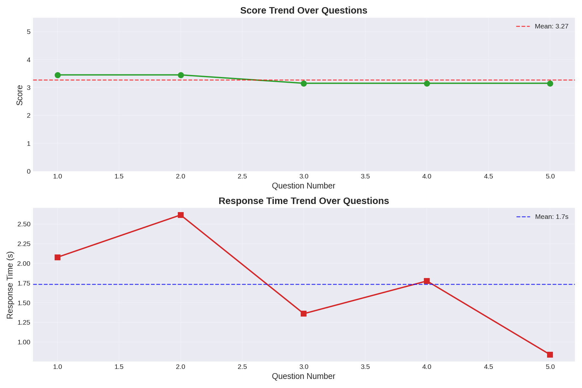
Baseline RAG Results: Performance Without Enhancement Stage
Overall Performance Score: The baseline RAG achieved an average score of 3.27 out of 5, indicating moderate effectiveness in generating responses.
Response Time Efficiency: Demonstrated a relatively fast response time of approximately 1.7 seconds, showcasing efficiency in processing queries.
Accuracy vs. Completeness: While accuracy in factual recall was high, there were notable deficiencies in completeness and coherence, limiting the utility of responses.
Photo by Luke Chesser on Unsplash
Notes:
The baseline RAG results reveal an average performance score of 3.27 out of 5, indicating a moderate level of effectiveness. The system demonstrated a relatively fast response time of approximately 1.7 seconds, which is commendable. However, despite high accuracy in factual recall, there were significant deficiencies in completeness and coherence, which limited the overall utility of the generated responses.

Slide 12

Full MedRAG Results: Performance With Hybrid Enhancement
Significant Performance Improvement: With the hybrid enhancement, MedRAG achieved an average score of 4.02 out of 5, reflecting a substantial increase in effectiveness.
Perfect Completeness Score: Completeness improved dramatically, reaching a perfect score of 5.0, indicating comprehensive responses to queries.
Enhanced Response Quality: Responses became more structured, analytical, and comprehensive, significantly increasing their research usefulness and depth of insight.
Photo by Reproductive Health Supplies Coalition on Unsplash
Notes:
The results from the full MedRAG implementation demonstrate a significant improvement in performance, with an average score of 4.02 out of 5. Notably, completeness reached a perfect score of 5.0, indicating that the responses generated are now comprehensive and well-rounded. The quality of responses has also improved, becoming more structured and analytical, which enhances their overall usefulness for research purposes.

Slide 13
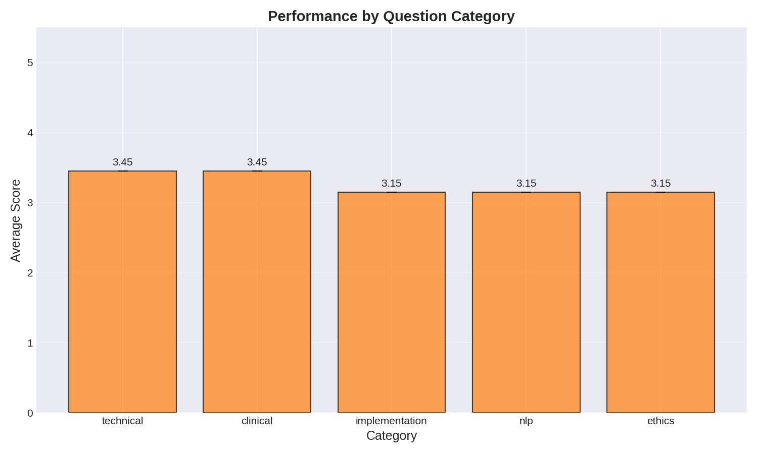
Quality vs. Latency Trade-Off: Performance Comparison
Performance Comparison: Baseline RAG achieved a score of 3.27, while MedRAG improved to 4.02, showcasing the effectiveness of the hybrid approach.
Latency Analysis: Baseline latency was approximately 1.7 seconds, whereas MedRAG's latency increased to around 31.7 seconds, reflecting the depth of processing involved.
Depth Over Speed: MedRAG prioritizes depth, quality, and comprehensiveness over raw speed, making it suitable for research intelligence applications.
Photo by Isaac Smith on Unsplash
Notes:
When comparing the performance of baseline RAG to MedRAG, we observe a notable improvement in quality scores, with MedRAG achieving an average of 4.02. However, this enhancement comes at the cost of increased latency, with MedRAG's response time rising to approximately 31.7 seconds. This trade-off highlights MedRAG's design philosophy, which prioritizes depth and comprehensiveness over raw speed, making it particularly well-suited for research intelligence applications.

Slide 14
Ethical & Safety Measures: The Medical Validator Agent
Preventing Diagnostic Claims: The Medical Validator Agent actively prevents the generation of diagnostic claims or medical advice, safeguarding patient safety.
Disclaimer Enforcement: This component ensures that appropriate disclaimers are included in all generated content, maintaining transparency and ethical standards.
Robust Safety Protocols: Achieved an average safety score of 0.71 out of 1.0, indicating strong adherence to safety protocols and responsible AI deployment.
Notes:
The Medical Validator Agent plays a crucial role in ensuring that MedRAG operates within ethical boundaries. It actively prevents the generation of diagnostic claims or medical advice, thereby safeguarding patient safety. Additionally, it enforces the inclusion of appropriate disclaimers in generated content, maintaining transparency. With an average safety score of 0.71 out of 1.0, this component demonstrates robust adherence to safety protocols, ensuring responsible AI deployment in sensitive healthcare contexts.

Slide 15



Limitations: Acknowledging Current Constraints
Evaluation Size Constraints
The current evaluation was based on a relatively small set of questions, which may not fully represent the system's capabilities.
Moderate Coherence Issues
Some complex responses exhibited moderate coherence and insightfulness, indicating room for improvement in reasoning.
High Latency Challenges
The system's multi-stage processing results in high latency, particularly for intricate queries, which may hinder user experience.
Notes:
While MedRAG shows promise, it is essential to acknowledge its current limitations. The evaluation was based on a relatively small set of questions, which may not fully capture the system's capabilities. Additionally, some complex responses displayed moderate coherence and insightfulness, indicating areas for improvement. The high latency associated with multi-stage processing, particularly for intricate queries, poses challenges that need to be addressed to enhance user experience.

Slide 16




Future Work: Enhancing MedRAG Capabilities
Multimodal RAG Integration
Future work includes integrating diverse data types such as images, tables, and charts to provide richer context and enhance response quality.
Adaptive Latency Control
Developing mechanisms to dynamically adjust processing speed based on query complexity and user needs will improve responsiveness.
Confidence & Trust Scoring
Implementing metrics to quantify the reliability and trustworthiness of generated responses will enhance user confidence in the system.
Improved Reasoning and Coherence
Further enhancements will focus on producing more sophisticated and logically consistent outputs, addressing current coherence issues.
Notes:
Looking ahead, there are several exciting avenues for enhancing MedRAG's capabilities. We plan to integrate multimodal RAG, allowing for the inclusion of diverse data types such as images and tables, which will enrich the context of responses. Additionally, developing adaptive latency control mechanisms will enable the system to adjust processing speed based on query complexity. Implementing confidence and trust scoring metrics will further enhance user trust, while ongoing improvements in reasoning and coherence will address current limitations.

Slide 17

Conclusion: MedRAG's Impact on AI + Healthcare Research
Effective RAG Solution: MedRAG offers a practical solution to the challenges posed by LLM knowledge cutoffs, ensuring timely and relevant information.
Outperformance of Naive RAG: The hybrid RAG approach significantly outperforms naive RAG, particularly for complex healthcare research tasks.
Grounded and Safe Insights: MedRAG successfully enables the generation of grounded, current, and safer AI insights for healthcare research.
Photo by Markus Winkler on Unsplash
Notes:
In conclusion, MedRAG represents a significant advancement in the application of AI within healthcare research. By addressing the limitations of traditional LLMs and providing a robust hybrid retrieval-augmented generation solution, MedRAG ensures that researchers have access to timely, relevant, and safe insights. Thank you for your attention, and I look forward to discussing the future of AI in healthcare research.

